Slide 1

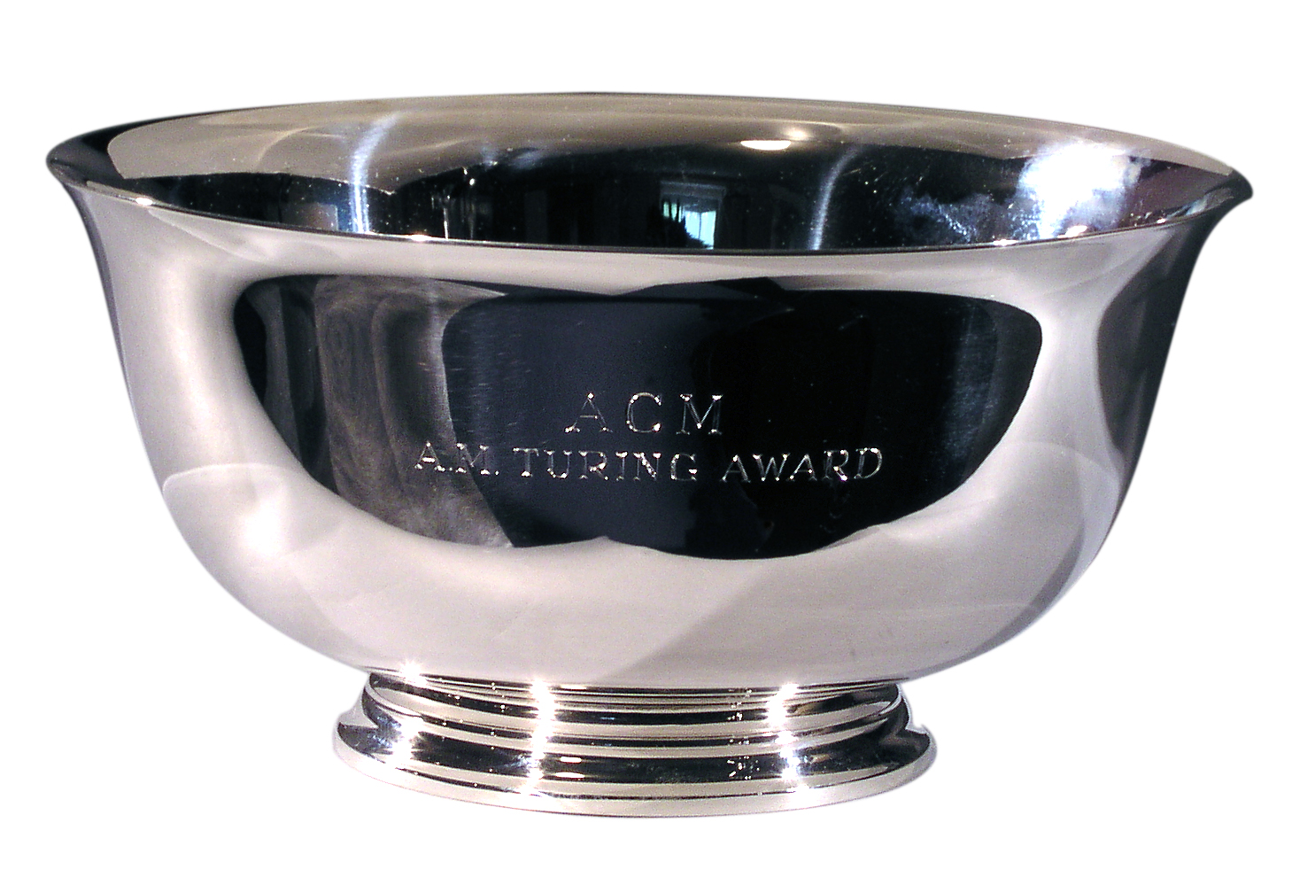
Research Methods in Computing Presentation
By Stephen Gallagher
By Jack Haugh

Slide 2


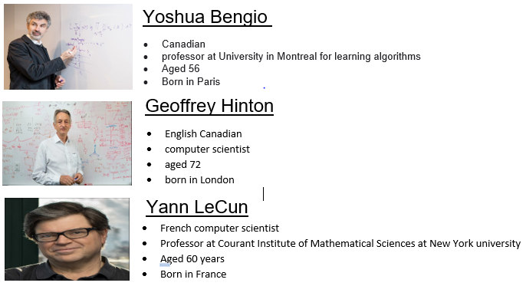
Turing award Winners 2019
Given to those who contributed “ lasting and major technical importance to the computer field".

Slide 3

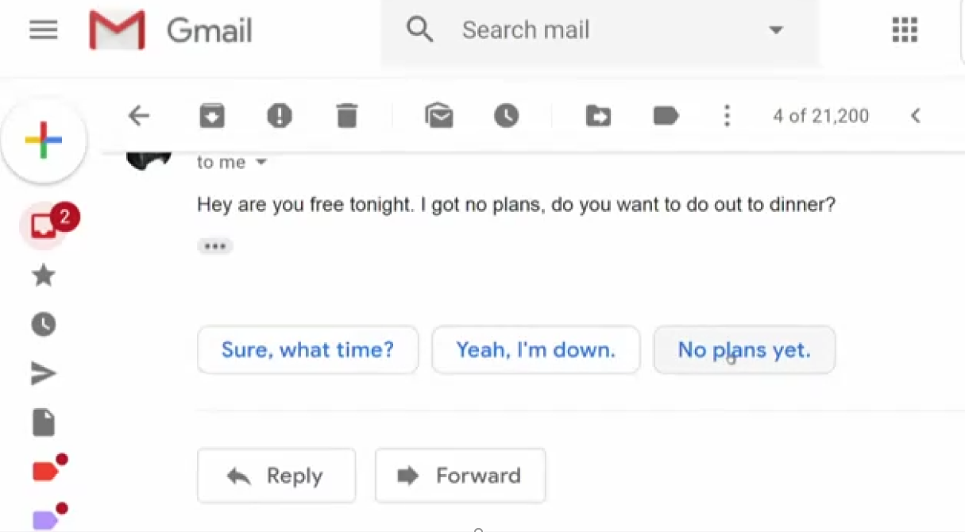
AI EXAMPLE

Slide 4

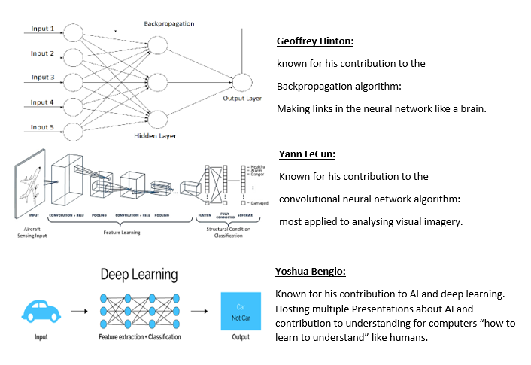
Each Scientists Contribution

Slide 5

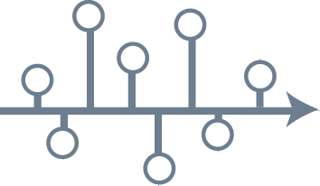
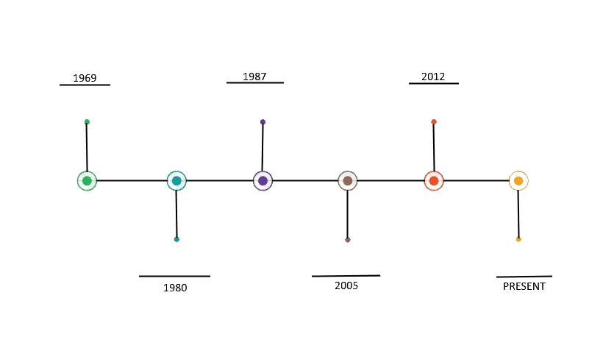
The Turing award winners Timeline

Slide 6

Any Questions?

